Slide 1

Mechanical Engineering Workshop
HKSKH Bishop Hall Secondary School
2021-07-26

Slide 2
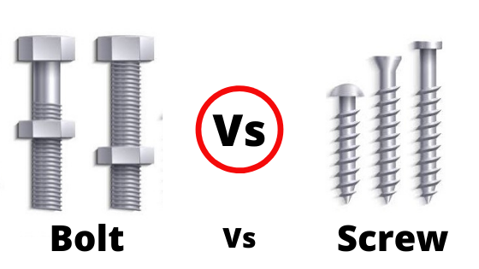
Fastener

Slide 3
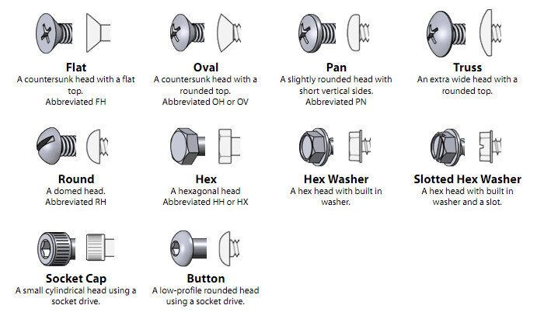
Head Type

Slide 4
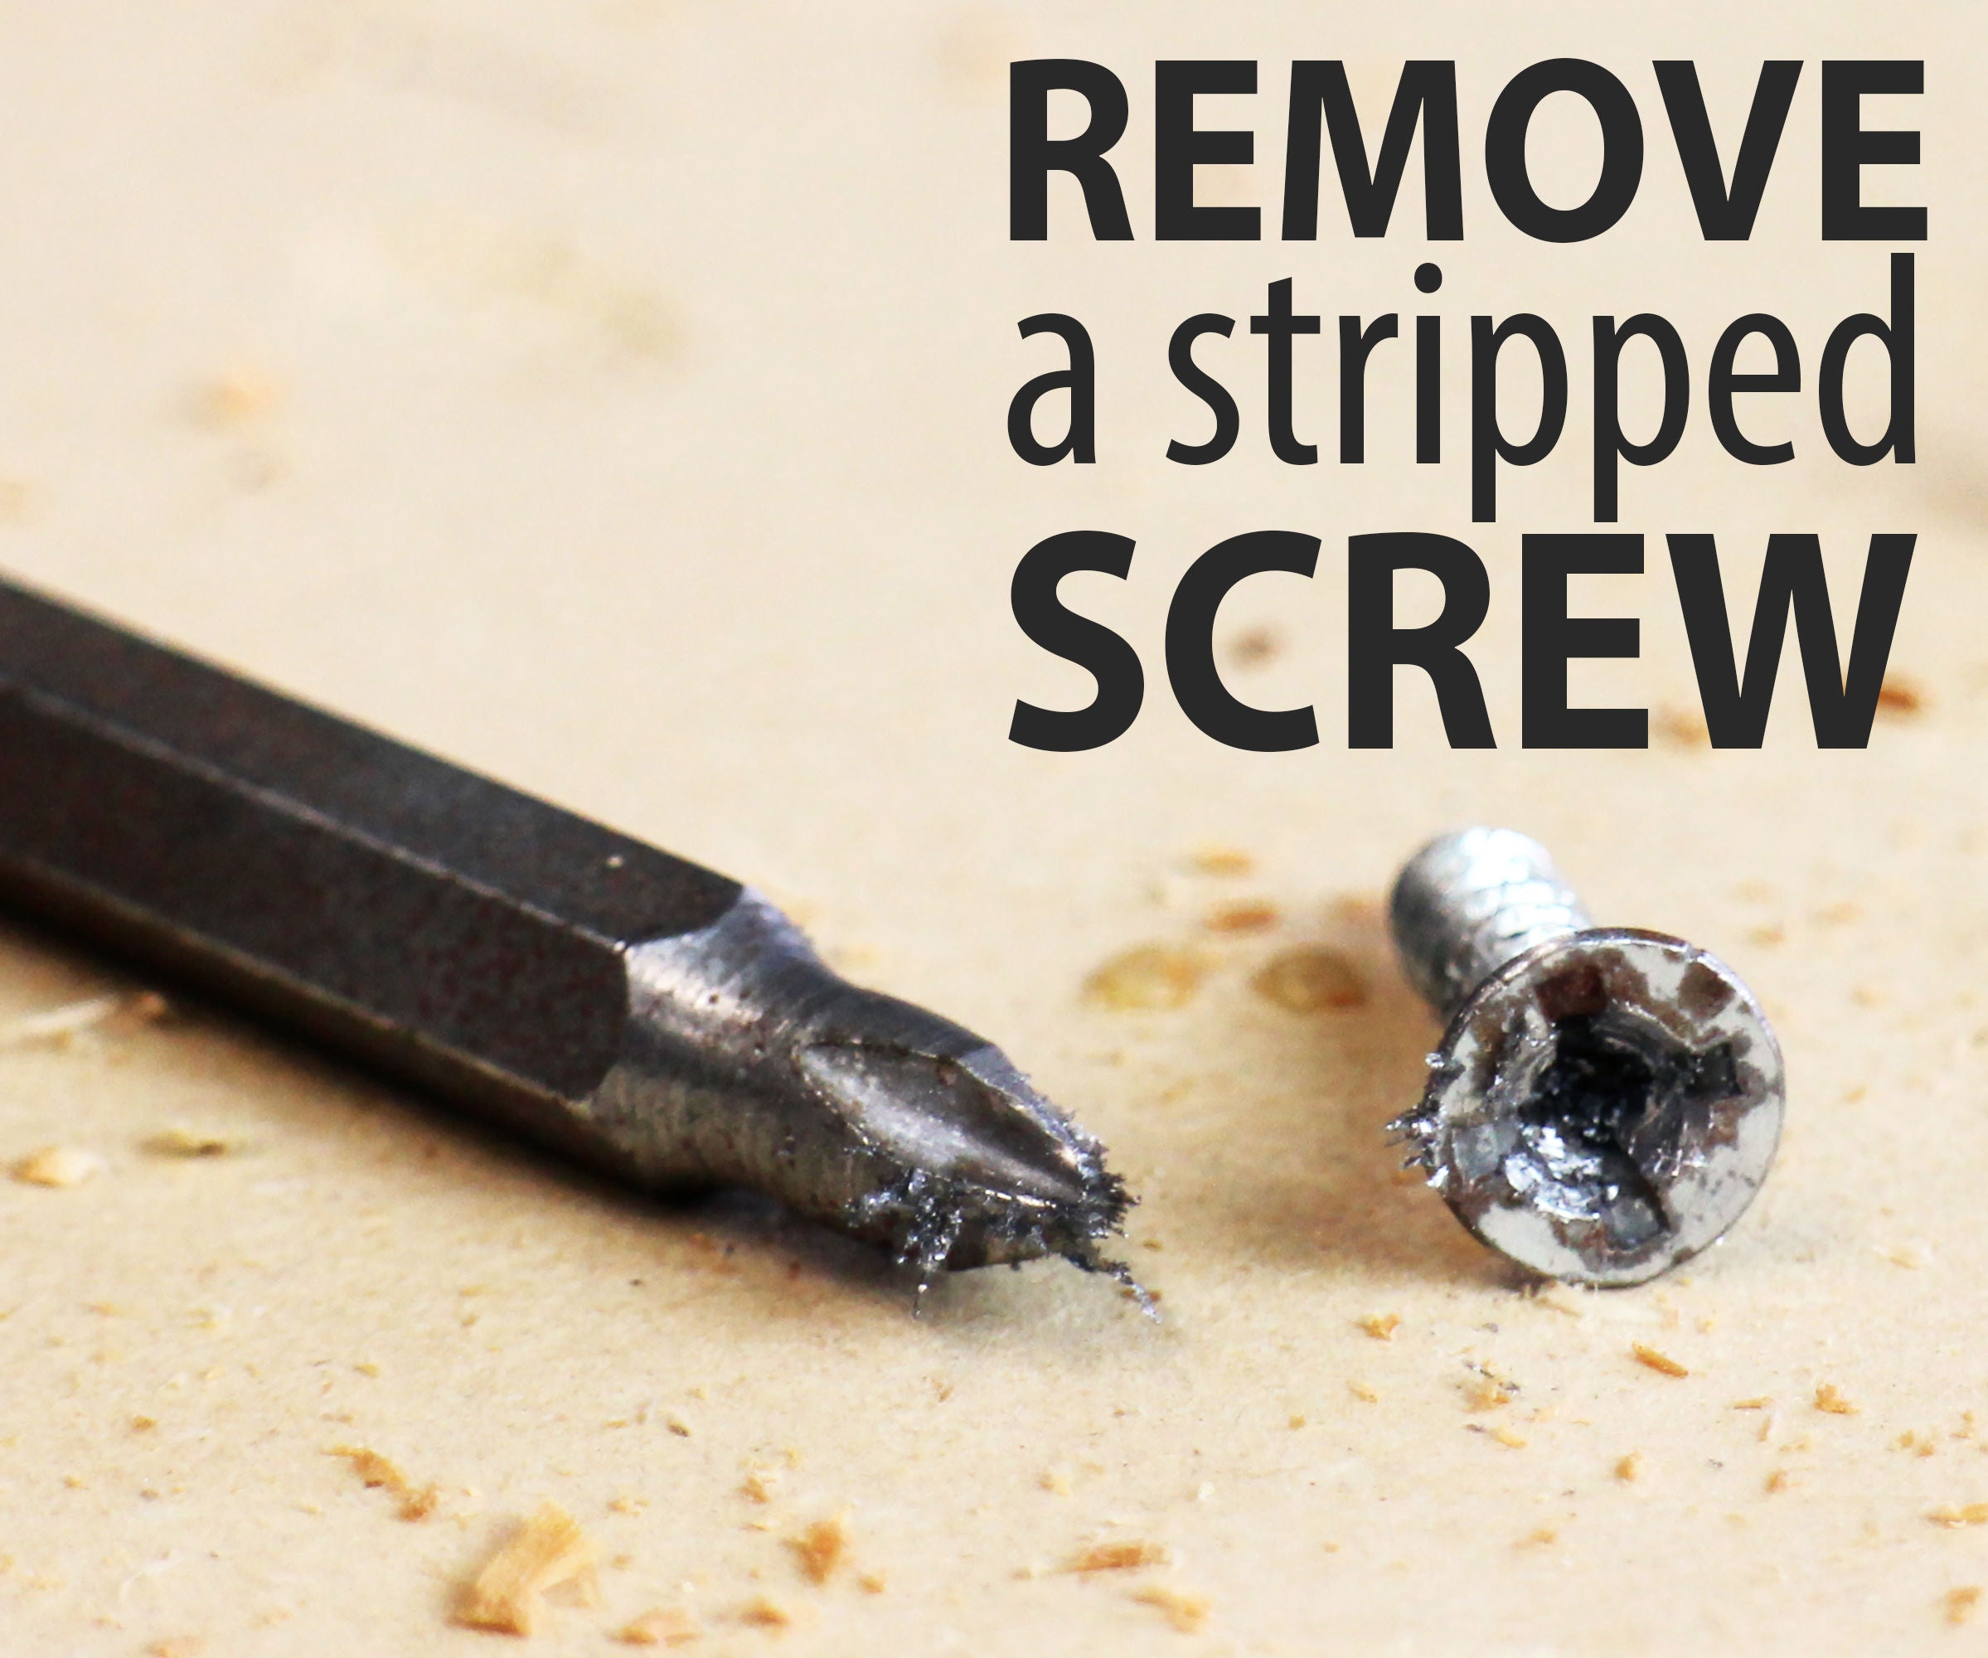
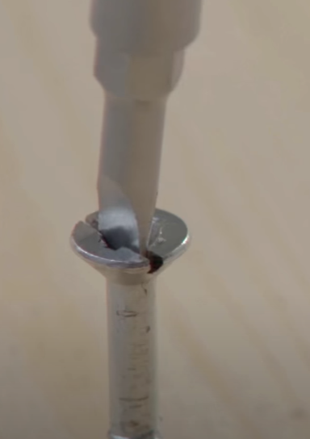
Stripped Screw

Slide 5
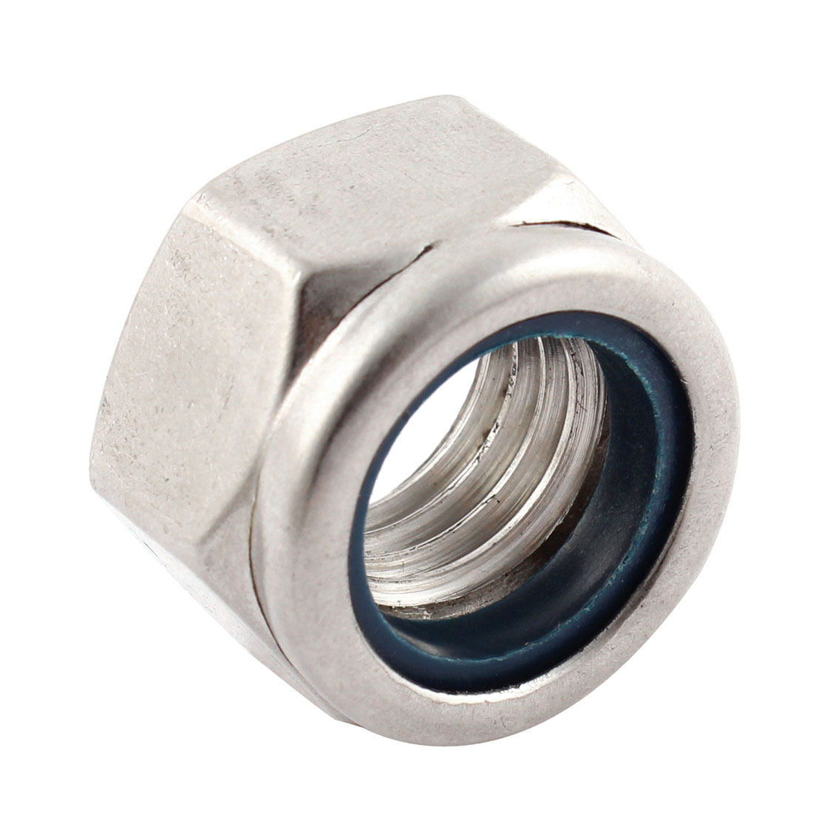
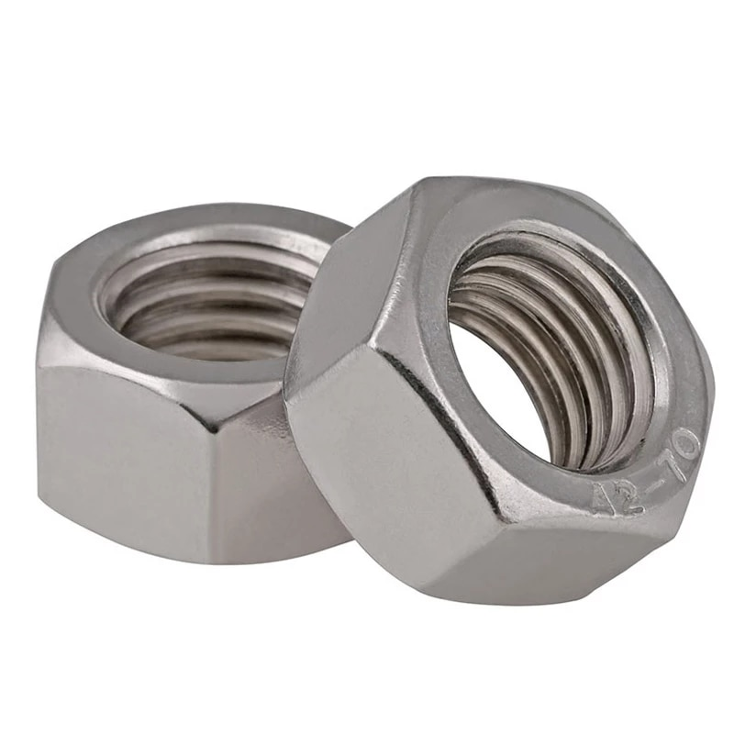
Nut
Anti- Loose Nut
Hexagonal Nut

Slide 6
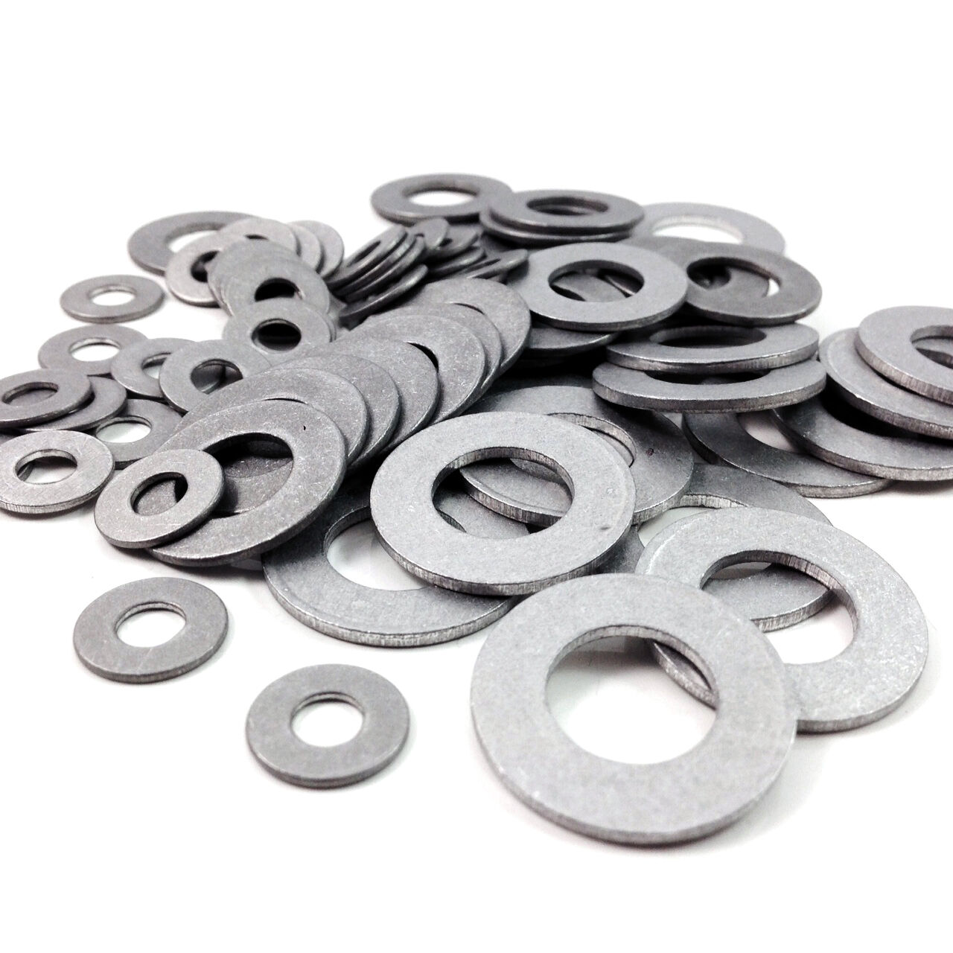
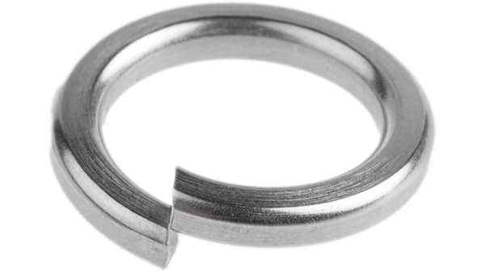
Washers
Flat Washer
Spring Washer

Slide 7
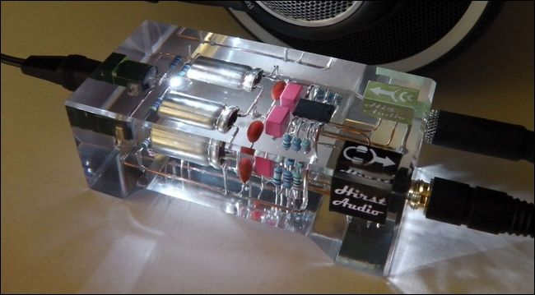
Water-proof
Epoxy

Slide 8
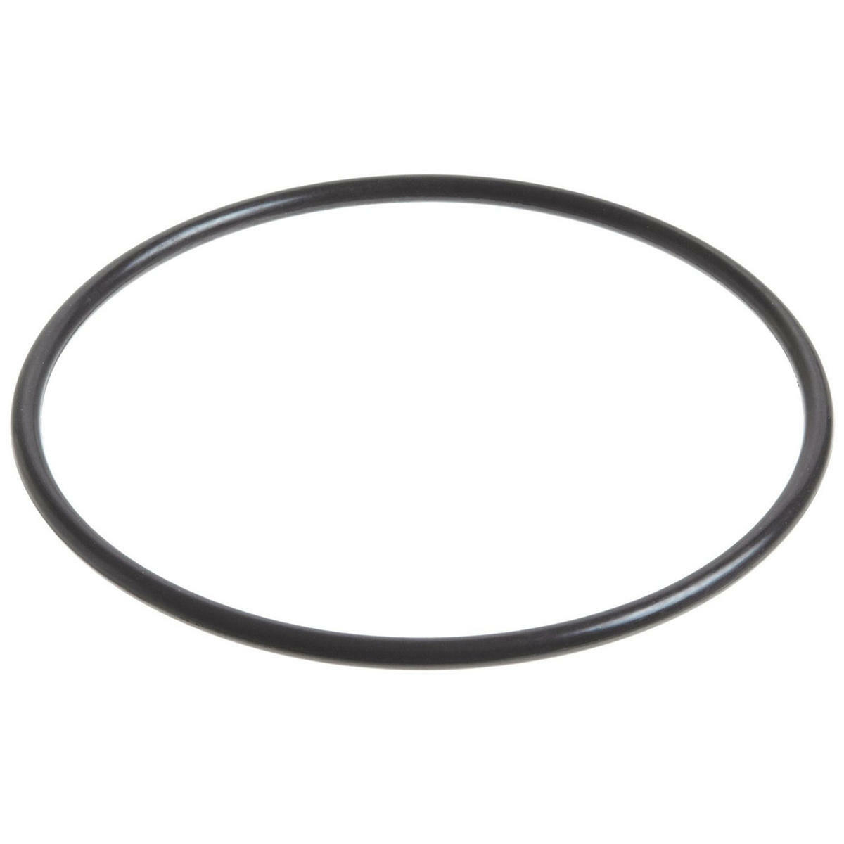
O-ring
https://www.youtube.com/watch?v=s5nJG0om8KY

Slide 9
Fusion 360

